Slide 1
School Board Experiences with the Learner Gains Research Project
A study completed for the CESBA LBS Committee
by Christine Pinsent-Johnson
Presented December 1, 2016
Notes:
This presentation is based on a report completed for a study initiated by the Literacy and Basic Skills (LBS) Committee. Committee members of CESBA, who represent the interests and concerns of managers of all school board LBS program. They decided to pursue a study after hearing about the challenges experienced by their colleagues participating in the Learner Gains Research Project (LGRP).

Slide 2

Notes:
The LGRP wrapped up November 30 (yesterday). The stated aims were to “explore options to further test the Essential Skills for Employment and Education (ESEE)” for use in the LBS accountability framework, and to gain “a better understanding of the experiences and progress of learners.”
ESEE was developed by the College Sector Committee (CSC), an LBS funded support organization, in partnership with the Essential Skills Group, a consulting business.
The test incorporates basic methodological principles and methods from the Organization for Economic Cooperation and Development’s (OECD) international literacy testing initiative, including levels, a scoring system, statements of literacy standards and test item design. Some of these methods and principles have been modified.
The ESEE is currently used as a screening tool, free of charge, by the CSC for their online high school equivalency program called ACE Distance (Academic and Career Entrance).

Slide 3
Data collection and analysis
Program | Participants | Learner Targets
DSB 1 | Manager | 102
DSB 2 | Manager and Instructor | 118
DSB 3 | Manager | 205 online and 46 in classes
DSB 4 | Manager | 50
DSB 5 | Manager | 4 in a specialized program
TOTAL |  | 525 (30% of proposed sample of 1800)
Notes:
Five school board programs were involved in the LGRP. Although this doesn’t seem like a lot, considering over 30 programs were involved, those five programs represented one-third of the learners in the target sample.
In addition, the school board sector can tell us a lot about what is happening in the province as a whole. EOIS-CaMS data tends to align with the provincial picture as school boards hug the middle so to speak between the profile of colleges and community programs, seeing both highly educated learners with academic goals similar to colleges and seeing learners with some challenges or those with more independence goals similar to community programs.
I call this a bellwether sample, not generalizable, but definitely highly informative and not to be dismissed or ignored. In addition the managers who participated wanted to participate in the LGRP. They were not reluctant nor cynical participants, but genuinely wanted to engage with the ministry and learn more about the proposed learner gains tool. In other words, they did start the project with concerns and worries about the test.

Slide 4
Purpose and questions/topics
LG project process and participation
  How did you get involved? What is the process you set up? Who do you talk to at the ministry?
Learner and instructor responses
  What do your learners say about their experiences taking the test? What have you noticed happening? What are your instructors telling you?
Alignments with the OALCF, and/or PLAR/GED or personal and job goals
  What do the results tell you?
Notes:
The research was carried out in June at the midpoint of the LGRP.
During our interviews I asked about
1. The administration of the ESEE
2. Learner perceptions of the test and an understanding of why they may struggle with the assessment, two areas of interest identified by the ministry in their initial memo to the field
3. In addition, the study aimed to understand and the (mis)alignment of the test with the OALCF and curriculum in use to support transitions into adult secondary credit.
Interviews lasted approximately one hour.
Notes were taken, written-up, and then returned to each participant for clarification and confirmation.
A couple of programs also collected their own data which they shared.
Participants were informed how their anonymity would be protected and how their data would be used (in a report to the ministry and here).
Each participant also received the completed report that was shared with the ministry.
Interviews revealed several pressing concerns that impact adult learners, instructors, program managers and the LBS system as a whole.

Slide 5
Main findings
Test-taking experiences
System misalignments
Administration challenges
Test design issues
Notes:
The findings are organized in four main categories in the report and in this presentation.
Test-taking experiences and learner perceptions of the test
System misalignments
Administration challenges
Test design issues

Slide 6
Test-taking experiences
  “Learners are feeling overwhelmed.”
  When students are initially asked to participate “they are eager.” Then they become “despondent and restless.”
  “Learners lose their motivation to upgrade. In some cases, learners have lost interest in upgrading due to the time consuming process of the ESEE assessment and exit the program.”
Notes:
1. Test-taking experiences and learner perceptions of the test
The test is simply too long and difficult, many learners needed more than twice the recommended time of one hour to complete, and some took up to four and five times longer. Instructors offered one-on-one support and encouragement.
“Learners are feeling overwhelmed.” said one participant.
When students were initially asked to participate, another explained, “They are eager.” Then they become “despondent and restless” when they realized how long the test is taking.
This participant noted that some learners then begin to click through the screens quickly and without paying attention in order to finish the test.
Another manager said some students have become very frustrated: “It just takes a lot of time. We’ve had some very angry people,” the manager said. One of the reasons for their anger is a personal question that is asked before students even start the test. They are asked about their mother’s education level. Students are offended by the question, explained the manager.
Most worrisome is some students may have left the program because of their experience. One manager explained,
“Learners lose their motivation to upgrade. In some cases, learners have lost interest in upgrading due to the time consuming process of the ESEE assessment and exit the program without doing what they originally came in to do.”

Slide 7
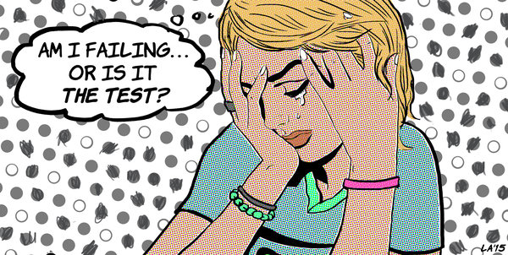
Test-taking experiences
  “The first time we did the ESEE we had people in tears.”
LA Johnson/NPR
Notes:
Counter to the intention of a pre-test, some instructors in one program are using the suggested activities to help prepare students to complete the ESEE. The manager explained that leaners’ experiences in a specialized program for older workers were so negative that they had no choice but to prepare those learners to take the pre-test. “The first time we did the ESEE we had people in tears,” the manager said. In addition to introducing practice activities the instructor in the program has developed a testing resilience program focused on “self-esteem and ego.”

Slide 8
Test-taking experiences
Learners may not have technical skills particularly in a test situation
  “We have to teach the students how to do the online test first. So how is this a good baseline measure?”
Technical issues with the test itself
Final score is reported before the learner completes which adds to learners’ frustration
Notes:
All participants mentioned technical challenges with the online format, including the need to teach learners how to navigate the test environment.
Learners may not have technical skills. If they have those skills, they may not be experienced or confident enough to use them in a high pressure testing situation.
“We have to teach the students how to do the online test first. So how is this a good baseline measure?” asked a manager.
One program has created a test preparation and support course to assist a group who had a particularly negative experience with initial testing.
Technical issues with the test itself include trouble logging in, navigational glitches, difficulty reading the print on the screen, and the need to scroll up and down to read test items.
An instructor hired specifically to oversee the project was perplexed by a convention built into the methodological framework of the test: it produced a final score before the learner had completed all of the test items. Learners were “stressing out” to complete the test, she explaianed, and then became aware that the final score was determined before they finished. They then became discouraged and wondered why they bothered making an effort to complete the test.

Slide 9
Test-taking experiences
Results have no relevance to transition goals and day-to-day program learning
  “We’re not doing anything with the results. Why should they even try?”
But viewed as a more “official’ test from the ministry
No flexibility or choice, unlike Milestones and CTs
Notes:
There is tremendous confusion, and both concern and apathy, among learners regarding the use and relevance of results since they are not related to secondary credit, PLAR or completing the GED.
Results have no relevance to transition goals and day-to-day program learning: “We’re not doing anything with the results. Why should they even try?” asked one manager.
Some students, explained another, see their results as an actual reflection of their abilities because the initiative is from the ministry. The ESEE is perceived to be more official than assessments used in the program, even though those assessments connect directly to the credit pathway and transition into the secondary system.
Another manager fears their program would have to close if the ESEE is used to generate a measure of program effectiveness within the PMF. “I think we’d be done,” they said starkly. The school board program has a specialized class for learners with multiple challenges.

Slide 10
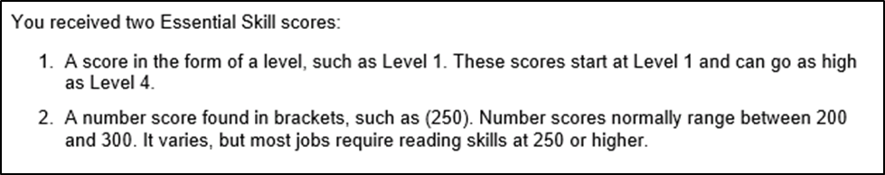
Test-taking experiences
“The assessment demoralizes the learner. Many felt unintelligent after taking the assessment due to the scoring framework. A pronounced number of the learners felt the score reflected a ‘fail’ result. No matter how I explained the scoring process, learners were adamant that the ‘number’ presented at the end of the assessments indicated they had failed – no matter the number, even some high scores. Many learners are already coming into the class with low self-esteem and difficulty staying on task – this assessment amplifies these feelings for the learner.”
Notes:
Learners interpreted final reports as messages of failure.
Here is the message they see once they have completed the test.
Review
The assessment demoralizes the learner. Many felt unintelligent after taking the assessment due to the scoring framework. A pronounced number of the learners felt the score reflected a ‘fail’ result. No matter how I explained the scoring process, learners were adamant that the ‘number’ presented at the end of the assessments indicated they had failed – no matter the number, even some high scores. Many learners are already coming into the class with low self-esteem and difficulty staying on task – this assessment amplifies these feelings for the learner.” (Instructor, DSB 2)
The use of “normal” scoring rages and cut-off scores related to employability and education access has not been validated nor empirically demonstrated. Learners who have previously experienced negative schooling experiences are further marginalized and demoralized.
In addition, test developers and the ministry had a very good indication of the scoring range for LBS but didn’t change these messages.
Based on a previous pilot of the test, the average score of over 500 learners was 210. The statements about a normal range for LBS (or anyone) are completely unfounded. The 250 cut-off was established by CSC for ACE entry, which is a high school equivalency program, is 250. Interestingly, one manager noted that students who passed the GED were scoring 225 on the ESEE. What exactly does 250 mean?
The other part of the statement addresses employability, falsely stating that “most jobs require reading skills at 250 or higher.”
The astounding contradiction here is that an EO program is sanctioning the use of an un-validated test to tell participants in one of their programs that they aren’t employable.

Slide 11
System misalignments
Managers and instructors discover that the ESEE score is
Not connected to OALCF and Milestone results
Not connected to the GED
Not connected to the Ontario secondary school curriculum
May not even be connected to international literacy testing results
Notes:
2. Fundamental system design misalignments
Managers and instructors discover that the ESEE score is
Not connected to OALCF and Milestone results
The OALCF levels are not aligned with the ESEE levels. Participants said they thought students would be prepared if they were at OALCF level 2, but these students have results at ESEE level 1, if they are able to complete the test at all.
It’s also not connected to the GED
The same manager who said students completing the GED scored 225 had to request exemptions from CSC for those who wanted to enter the ACE program. “If we were to force them, they would just walk.”
And it’s not connected to Ontario secondary school curriculum
One manager had a group with Grade 10 who took the test preparing to re-enter high school at Grade 11 but their scores were “all over the place”
The ESEE scores may not even be connected to international literacy testing results, which is the main goal of this project and the OALCF, due to unique design features in the ESEE and deviation from the methods.
PIAAC less than high school =234
PIAAC high school = 267

Slide 12
System misalignments
ESEE has three sections:
Reading
Document Use
Numeracy
Learners resent having to take the reading and document use tests, which may take 2-4 hours when they are in a program to brush up on math
  “Learners really don’t care about the OALCF. They want to learn to cross multiply a fraction to get into Grade 10.”
Notes:
Learners must take all three sections of the ESEE despite program goals, which may be focused only on numeracy.
ESEE has three sections:
Reading
Document Use
Numeracy
Learners resent having to take the reading and document use tests, which may take 2-4 hours when they are in a program to brush up on math
“Learners really don’t care about the OALCF. They want to learn to cross multiply a fraction to get into Grade 10.”

Slide 13
System misalignments
Learners are reluctant to do the post test because of the time, difficulty and irrelevance
  “They just answered anything to get it done.”
Learners don’t see a connection between the ESEE and what they are doing in the program.
  “We prepare them for credit but LG shows no score difference. It’s counter-intuitive to what we are doing. It’s not related to credit learning whatsoever.”
Notes:
Some post-tests were completed at the time of the interviews and managers noted that there was either no change or even a score decrease.
The decrease is likely due to learners’ frustrations: some learners are very reluctant to complete the post-test and are simply moving through, clicking randomly on responses. “They just answered anything to get it done.”
Learners weren’t seeing a connection between the ESEE and what they are doing in the program.
We prepare them for credit but LG shows no score difference. It’s counter-intuitive to what we are doing. It’s not related to credit learning whatsoever

Slide 14
System misalignments
The test results and the emphasis on testing something that is irrelevant to learners and programs sends the signal that what programs actually do isn’t valued.
  “The assessment does not meet the needs of learners. It’s not learner-centred. If someone transitions and they are happy, isn’t that enough?”
Notes:
The test results and the emphasis on testing something that is irrelevant to learners and programs sends the signal that what programs actually due isn’t valued. In a completely distorted way, the ministry is holding programs accountable for things they don’t actually do.
The ministry is not actually counting what counts in programs and what programs spend their time doing. We are helping people in so many ways in the community and none of this counts, explained a manager. Without programs like ours, “we’d have a lot of lost learners in the community.”
“The assessment does not meet the needs of learners. It’s not learner-centred. If someone transitions and they are happy, isn’t that enough?”

Slide 15
System misalignments
System misalignments have led to both pedagogical and testing confusions and professional compromises
PLAR, GED, Grade 10 literacy test
ESEE, OALCF, Quill activities
Notes:
Those who were working with learners were put into professionally compromising and contradictory positions as they attempted to justify and explain the test and its relevance.
Instructors were put in an awkward position as they attempted to encourage learners to take and complete the test, and then had to explain the test was not relevant to program goals once learners received results below or at the low end of what has been deemed the ”normal range”.

Slide 16
System misalignments
“They get them [the results] back and then they get totally decimated. In the online environment, they just disappear.”
Notes:
Another manager explained that they “downplayed” the meaning of the results and final scores. “They get them [the results] back and then they get totally decimated. In the online environment, they just disappear.” Yet, when preparing students to take the test they also “played up” the benefits of the test, telling students its helpful if their goal path is employment and the results will give them a “starting point.” Such an attempt to find meaning in the test could back-fire if the student receives a score below 250 that suggests they aren’t employable.

Slide 17
System misalignments
One manager expressed a great deal of concern about the future viability of their program.
  “All of a sudden, all of these possibly out of context scores will be used to judge our programs. They’re going to show learner loss.”
Notes:
A couple of managers are very concerned about the use of results. One manager expressed a great deal of concern about the future viability of their program.
“All of a sudden, all of these possibly out of context scores will be used to judge our programs. They’re going to show learner loss.”

Slide 18
Administration challenges
“It’s taking more time away from teaching in the class. It’s another layer on top of what we do. It’s to the detriment of our staff as it adds to their workload.”
Notes:
3. Administration challenges
The pre-test over-burdened an already lengthy intake process and increased staff workloads.
Although programs were provided funding to offset these costs, one manager wondered if core funding would increase.
“It’s taking more time away from teaching in the class. It’s another layer on top of what we do. It’s to the detriment of our staff as it adds to their workload.” (Manager, DSB 1)

Slide 19
Administration challenges
One program exempted 80%
  “We actually had people drop out of our program because of the ESEE.”
Even instructors who tried the test were shocked at their low scores
Many students who did the pre-test refuse to do the post-test because of their negative experiences or they simply “disappear”
Notes:
Managers said they had a difficult time recruiting learners to participate in the project, as test results have no relevance to their learning and program goals.
One program exempted 80%
“We actually had people drop out of our program because of the ESEE.”
Even instructors who tried the test were shocked at their low scores
Even more challenging, is convincing learners to take the post-test since most had negative experiences with the pre-test (is too difficult and takes too long).

Slide 20
Administration challenges
Difficulties running the project over the summer
Unable to communicate concerns directly with the coordinators of the project
No informed consent process
Notes:
Running the project over the summer was a challenge as programs usually close down and end an academic year. Many learners who did the pre-test in the spring may have completed their program involvement with no plans to return in September.
Managers felt isolated and want to communicate their challenges directly to the coordinators of the LGRP. They had no direct contact with the coordinators of the study. They were advised to contact their Employment Training Consultants (ETC’s) in an online posting. One manager said the ETCs weren’t necessarily aware of the project.
Ministry officials set up a study involving approximately 1800 learners in over 30 programs across Ontario without a process to obtain informed consent from study participants. They did not provide participants with information about their rights, including their right to withdraw from the study without repercussions. They did not include information about contacting the study’s coordinators if study participants had concerns or questions. And they did not inform participants about how their data would be used. In addition, they paid programs to participate in the study, adding an additional layer of obligation to participate, without any recourse to raise concerns or be informed of one’s rights as study participants.

Slide 21
Design issues
Reading comprehension
Information-processing
Notes:
4. Test design issues
A content analysis reveals a unique pedagogical approach built into the ESEE and other spin-offs including the OALCF Milestones. The decision to align the LBS system with international literacy levels, scores and standards statements (i.e. descriptions of complexity) means adults are learning a perverse pedagogy of reading that contradicts literacy learning in the secondary credit, postsecondary and apprenticeship paths, Ontario’s K-12 system and predominant approaches to teaching literacy.
Information-processing is an invention for test development. No one actually handles texts in everyday life in the way prescribed by the tests and materials that are developed using this model.
Those texts and materials include ESEE, Milestones, PDQ, OSP, Measure Up, Quill LBS Activities, etc.
In addition, information-processing or what is simply called a task-based approach contradicts reading comprehension approach used in OSSLT, PLAR, Ontario Curriculum, GED, traditional adult literacy materials (e.g. Laubach, Grass Roots Press), etc.
However, in order to complete activities using information-processing one needs a solid foundation of reading comprehension skills, strategies and knowledge to draw on. Insisting that LBS programs align their teaching to the OALCF, Milestones, Quill activities, and other similar materials is astoundingly perverse.

Slide 22
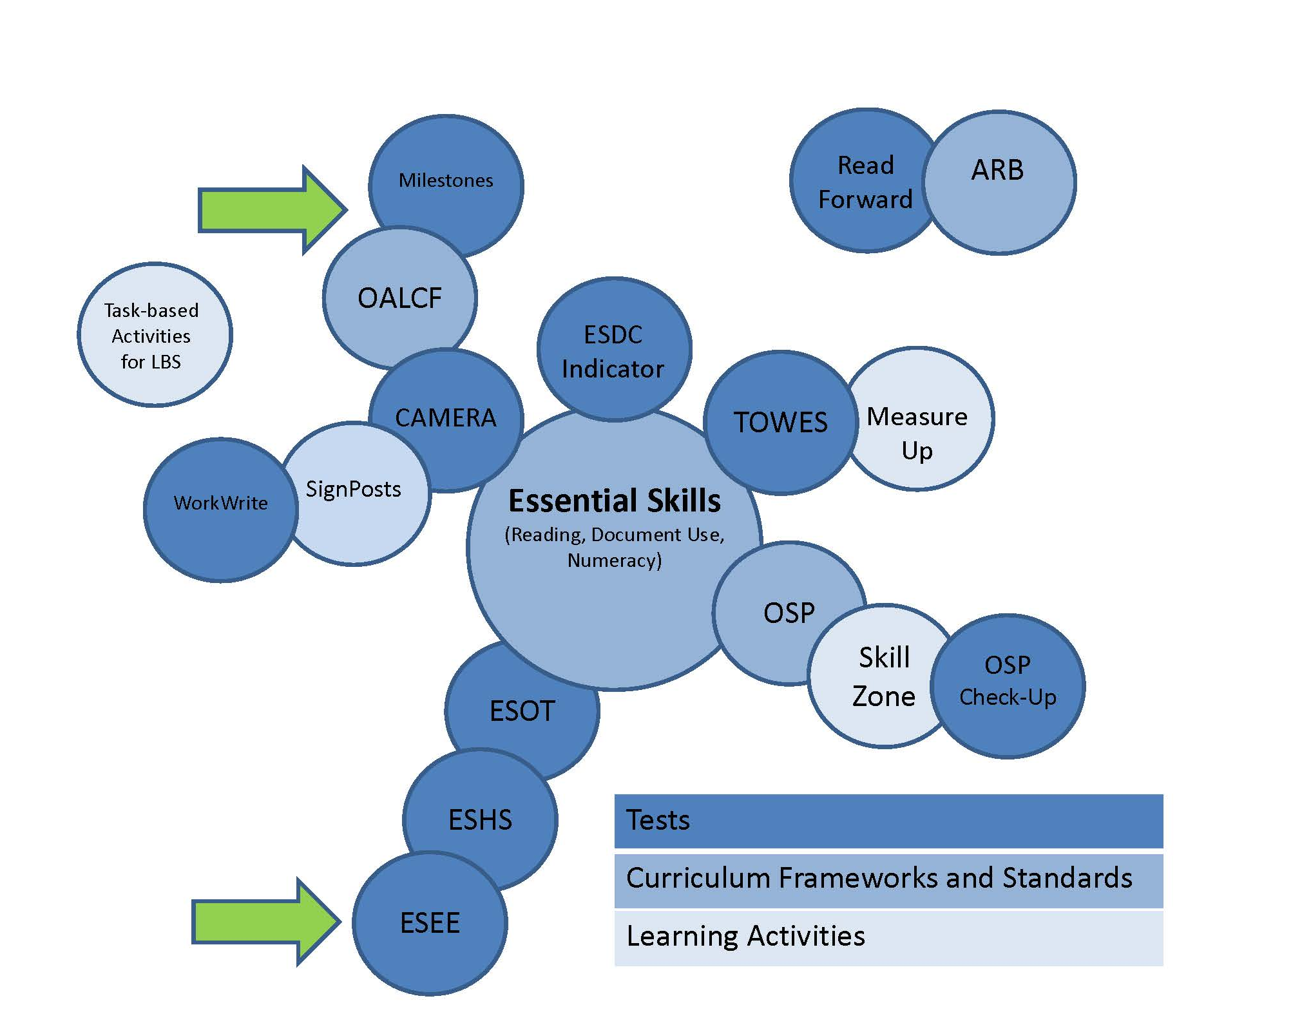
Notes:
The main project that helped to move the international testing methods into Ontario programs was the Essential Skills with its curriculum framework, trained profilers, advocates and most importantly funding from the federal government.
Handout
Information-processing and ESEE reading items require the test-taker to…
Scan quickly and superficially
Search for potential matches and responses without getting side-tracked
Set up a mental system to determine an ideal match
Discard extraneous and interfering information
Disconnect personal experiences, thoughts and opinions from the reading process.
Rely on technical skills only and not content, context and experience
Reading comprehension approach seen in PLAR and OSSLT require the test-taker to…
Read intently from beginning to end
Pay attention to detail
Develop knowledge of various text structures and how they are organized
Articulate and draw on technical knowledge (grammar, vocabulary_
Draw on personal content knowledge and cultural knowledge
Develop new knowledge from the text in order to respond to questions
Make personal connections with the content in order to relate experiences and opinions with the author or content
Learn how to use text to understand other points of view and actions
Integrate reading with writing skills to support deeper reading and thinking.

Slide 23
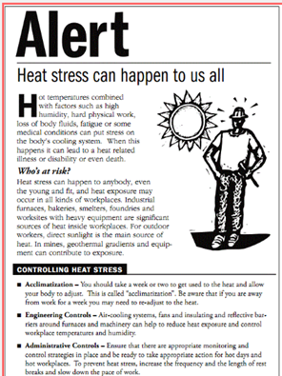
Warning!
Readability = Grade 11-12
Questions add to the difficulty
Notes:
Heat Alert Sample from LGRP training documentation
The ESEE introduced new issues.
1. Disturbing messaging in its content
2. An inappropriate and unfairly high readability level
A content analysis of the 25 reading items also revealed some very disturbing messaging focused on warnings, disciplinary and corrective processes, and even instilling a sense of fear.
Test items contained one of the following types of content:
1.General warnings and legal cautions
Warnings of imminent danger, injury and death
Warnings about breaking the law and
2. Workplace warnings and rules/policies
Warnings of imminent danger, injury and death on the job
Descriptions of accidents and injuries
Descriptions of workplace violence and harassment
4. Accessing ACE and online learning =
General information, rules and procedures for participating in ACE or general online college courses including warnings about plagiarism
Two of the 25 items don’t follow this pattern and were bizarrely focused on chemistry processes
Textbook excerpts about polymer and heat recovery from milk
The most serious problem, in this particular reformulation of the methods, is the difficulty of test-items. A readability analysis of all 25 ESEE reading items, including the six pre-test items, revealed that the texts are written at a senior high school reading level (Grades 11-12). The average grade level of most texts that people encounter in their daily lives is Grades 7-10 (e.g., newspapers, websites, fiction, self-help books, etc.). The average grade level of texts used in international literacy testing is Grade 8. It is not clear why the ESEE contains test items that are much more difficult.
Heat alert example was made available by CSC in training documentation for the LGRP. It’s a good example since it fits the average readability levels and we can see what makes Grade 11-12 texts so difficult.
Adding to the difficulty is the test question.
What is true about heat stress?
It affects young workers who are very fit
It affects older workers who are unaccustomed to the heat.
Bakers can suffer from heat stress
All of the above

Slide 24
Conclusions
The impacts of the use of the ESEE as part of the LGRP are serious and damaging, not only to adult learners, but also to individual programs and the LBS system as a whole.
Notes:
The ESEE test produces failure. Messages of failure are built into the test and the test sets up students to fail by using texts with a Grade 11-12 reading level.
The use of cut-off scores and normal ranges is unsubstantiated.
The test demoralizes many students and may directly impact student enrollment.
The results are meaningless to learners and individual programs since they aren’t aligned with the OALCF or the curriculum in use in the secondary credit path
The results may likely prove to be meaningless for the ministry as well; it is highly unlikely that they will show statistically significant increases between pre and post testing.
Use of the ESEE or any international literacy spin-off marginalizes and disconnects programs from the predominant approach to teaching literacy and the curriculum in use to support further education goals.
The only value of a score mentioned was for those students who want to enter ACE. In addition, the only texts with some contextual cues in the ESEE are related to ACE. The built-in bias is not appropriate in a test that is supposed to be used in the LBS system. In addition, the reference contradicts the basic methodological principles used to develop other test items.
Learners have been subjected to an unfair test that was not adequately validated for use in LBS, even for piloting purposes.
The ministry must seriously consider whether it is worth pursuing the use of a learner gains tool that aligns with international literacy levels and the 500 point scoring system after nearly a decade of work and the consideration of four different tools.

Slide 25
Conclusions
The costs of obtaining a score are high, and it is the learners who take on the burden.
  “We seem to be down-loading a lot on learners and they don’t need it. We’re in it for the learners, but for some reason we seem to be bogged down in the data. TCU has no idea of the impact of down-loading.”
Notes:
The costs of obtaining a score are high, and it is the learners who take on the burden.
“We seem to be down-loading a lot on learners and they don’t need it. We’re in it for the learners, but for some reason we seem to be bogged down in the data. TCU has no idea of the impact of down-loading.”

Slide 26
What happened next…
This report was presented to four ministry staff who attended a meeting of CESBA’s LBS Committee on August 11, 2016.
Notes:
To date, the ministry has not requested feedback from participating programs beyond reporting ESEE results in EOIS-CaMs (the reporting system used for data collection related to student registration and tracking), even though they state that one of their interests is to “understand learner perceptions around this type of assessment and understand why learners may struggle with the assessment.”

